Slide 1

Objectives
In this session, you will learn to:
  Describe the purpose of session management
  Design a web application that uses session management
  Develop servlets using session management
  Describe the cookies implementation of session management
  Describe the URL-rewriting implementation of session management
Notes:
Start the session by explaining the objectives listed in Slide 1. Session management allows web applications to store data for a particular client across multiple HTTP requests. Because HTTP is a stateless protocol, the Servlet specification provides an API to manage session attributes. This module describes two web container implementation strategies for session management (cookies and URL-rewriting) and the implications for web application development for each strategy.
There are two demonstrations in this module: one for the cookies implementation and one for the
URL-rewriting implementation of the Soccer League example.
Use the following flow for this module:
● Describe the purpose of session management
● Design a web application that uses session management
● Develop servlets using session management
Exercise 1: Implement the Set user preferences use case
You can do this exercise now or wait until the end of the module.
● Describe the cookies implementation of session management
● Describe the URL-rewriting implementation of session management
Exercise 2: Refactor the DVD application to use URL rewriting

Slide 2
HTTP and Session Management
HTTP is a stateless protocol. Each request and response message connection is independent of all others. Therefore, the web container must create a mechanism to store session information for a particular user.
Notes:
Use this slide to explain about the HTTP and session management.

Slide 3
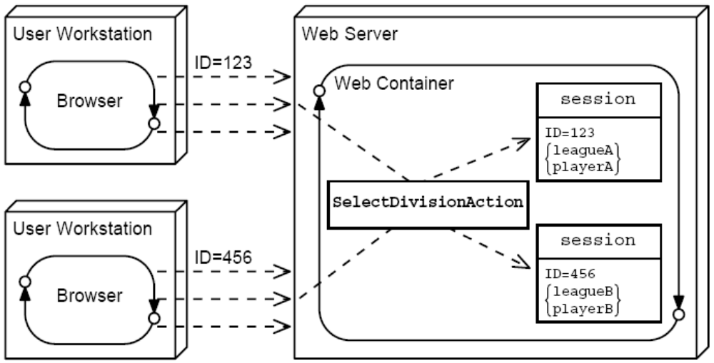
Web Container Sessions
The web container can keep a session object for each user:
Notes:
Use this slide to explain about the Web container sessions.

Slide 4
Designing Web Applications
The following is just one technique for designing web applications using session management. There are three steps to this design process:
  1. Design multiple, interacting views for a use case.
  2. Create a Struts application controller for each activity in the use case.
  3. Create a unique Struts URL for each activity in the use case.
Notes:
Use this slide to explain about designing Web applications to use session management.

Slide 5
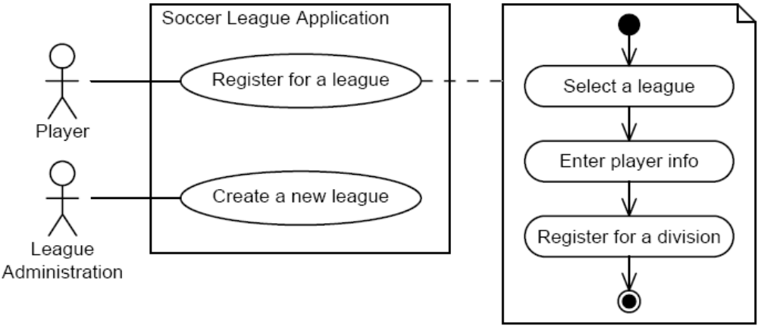
Registration Use Case Example
The following is the use case for on-line league registration:
Notes:
Use this slide to explain the Register Use Case example.

Slide 6
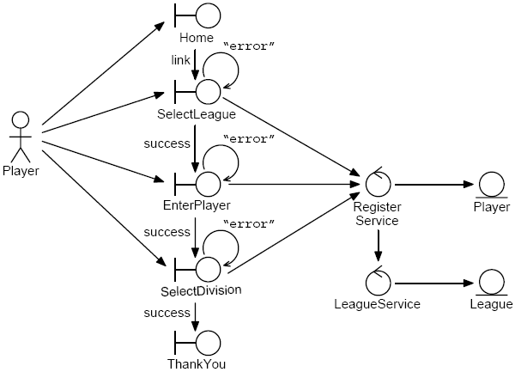
Registration Use Case Analysis Model
Notes:
Use this slide to explain the Register Use Case Analysis model.

Slide 7
Using Session Management in a Web Application
Using session management:
  Each activity-specific action must store attributes (name/object pairs) that are used by other requests within the session.
  Any action can access an attribute that has already been set by processing a previous request.
  At the end of the session, the action might destroy the session object.
Notes:
Use this slide to explain about using session management in a Web application. Sessions are a relationship between the client, a web browser, and the web application. A user can have two independent sessions at one time if they are using two different browsers at the same time to access the site. By different browsers this typically means browsers from different vendors: Netscape Navigator as opposed to Microsoft Internet Explorer, for example. On some platforms, such as Solaris Operating System, if you start two independent Netscape processes, then they will also have different sessions. On a Microsoft Windows platform, two Internet Explorer windows (if opened from the desktop icon) will result in separate sessions. But if the second window is opened by selecting File then New Window from within Microsoft Internet Explorer, the second window has the same session ID.

Slide 8
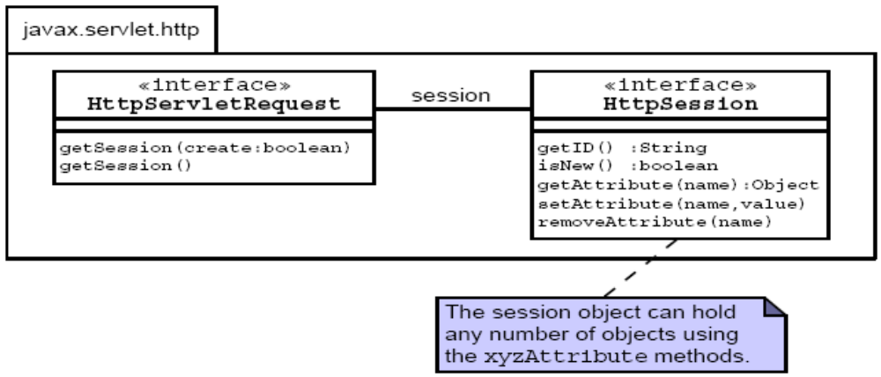
Session API
Your action controller accesses the session object through the request object.
You can store and access any number of objects in the session object.
Notes:
Use this slide to explain the Session API. Explain the methods of the HttpServletRequest interface, as given in page 8-8 of the SG.

Slide 9
Storing Session Attributes
58
59 // Perform business logic
60 ServletContext context = getServlet().getServletContext();
61 String dataDirectory =
(String)context.getAttribute(“sl314.model.dataDirectory”);
62 RegisterService registerSvc = new RegisterService(dataDire
63
64 // Retrieve the league
65 League league = registerSvc.getLeague(year, season);
66
67 // Store the league object in the session-scope
68 HttpSession session = request.getSession();
Looks up the league object (line 62)
Retrieves the session object (line 65)
Stores it in the league attribute in the session (line 66)
Directs the FrontController to the next view (line 69)
Notes:
Use this slide to explain about storing session attributes.

Slide 10
Accessing Session Attributes
The SelectDivisionAction retrieves the league and player objects from the session:
  47 // Retrieve the league and player objects from the session
  48 HttpSession session = request.getSession();
  49 League league = (League) session.getAttribute(“league”);
  50 Player player = (Player) session.getAttribute(“player”);
  51
  52 ServletContext context = getServlet().getServletContext();
  53 String dataDirectory = (String)context.getAttribute (“sl314.model.dataDirectory”);
  54 RegisterService registerSvc = new RegisterService(dataDirec
Notes:
Use Slides 10 and 11 to explain about accessing session attributes. The getAttribute method returns null if there is no attribute in the session scope with the name specified in the argument to the getAttribute method.

Slide 11
Accessing Session Attributes (Contd.)
Views (such as the ThankYou component) might also:
  Access session attributes:
    34
    35 // Retrieve the ‘league’ and ‘player’ from the session-scope
    36 HttpSession session = request.getSession();
    37 League league = (League) session.getAttribute(“league”);
    38 Player player = (Player) session.getAttribute(“player”);
  Generate a dynamic response using the attributes:
    59 // Present the main body
    60 out.println(“<p>”);
    61 out.print(“Thank you, “ + player.getName() + “, for registering “);
    62 out.println(“for the <i>” + league.getTitle() + “</i> league.”);
    63 out.println(“</p>”);
    64

Slide 12
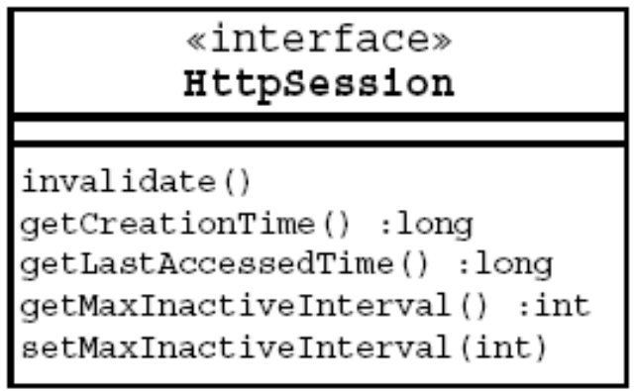
Destroying the Session
You can control the lifespan of all sessions using the deployment descriptor:
  126
  127 </web-app>
  128
You can control the lifespan of a specific session object using the following APIs:
Notes:
Use Slides 12 and 13 to explain about destroying the session. You can end a session:
Automatically by servlet container if a session is inactive for a specified time. You can specify the amount of time after which to invalidate a session.
By calling the HttpSession.invalidate() method on the session object.
The default timeout period is vendor-specific. You can obtain the timeout period via the int getMaxInactiveInterval() method of the HttpSession interface. You can change this timeout by using the setMaxInactiveInterval(int) method of the HttpSession interface.
The session will never expire if the timeout period for a session is set to -1 (or ANY NEGATIVE). The session invalidation will not take effect until all servlets using that session have exited the service method.
You can also configure session timeout by using the deployment descriptor (web.xml). You can specify the value (in MINUTES) of the session-timeout element to define the default session timeout interval for all sessions created in the Web application.
There is a hidden difficulty in using the invalidate method to destroy a session. Some web containers use the session object to store authentication information. If the session is destroyed, the user might be forced to re-authenticate.

Slide 13
Destroying the Session (Contd.)
Session objects can be shared across multiple actions (for different use cases) within the same web application.
Session objects are not shared across multiple web applications within the same web container.
Destroying a session using the invalidate method might cause disruption to other servlets (or use cases).

Slide 14
Using Cookies for Session Management
IETF RFC 2109 creates an extension to HTTP to allow a web server to store information on the client machine:
  Cookies are sent in a response from the web server.
  Cookies are stored on the client’s computer.
  Cookies are stored in a partition assigned to the web server’s domain name. Cookies can be further partitioned by a path within the domain.
  All cookies for that domain (and path) are sent in every request to that web server.
  Cookies have a lifespan and are flushed by the client browser at the end of that lifespan.
Notes:
Use this slide to explain about using cookies for session management. Cookies for a session identifier are not stored to a file by default. They are only stored in the browser’s memory. If you kill the browser, you will no longer be able to find your session. You can use the setMaxAge() method on the Cookie object to set the time-out period.

Slide 15
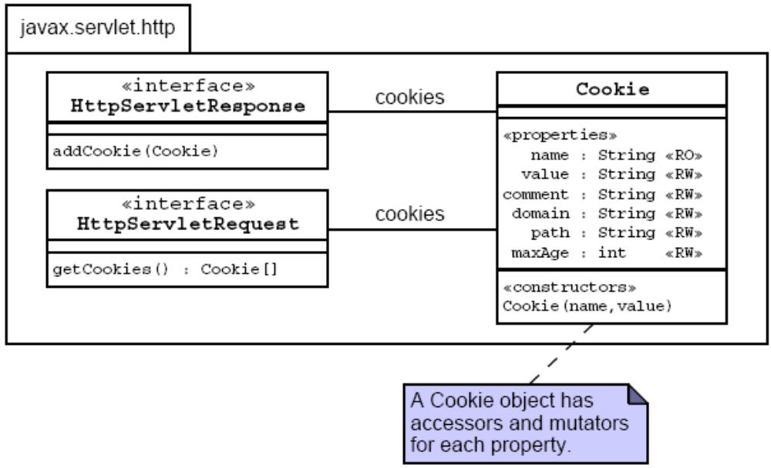
Cookie API
Notes:
Use this slide to explain about the Cookie API. The use of the properties stereotype in the cookie class diagram indicates that these are JavaBeans component properties having both the accessors and the mutators methods. For example, the maxAge property implies that the Cookie class includes getMaxAge() and setMaxAge() methods. The RO and RW stereotypes indicate whether the property is read-only or read-write respectively.

Slide 16
Using Cookies Example
The code to store a cookie in the response:
  String name = request.getParameter("firstName");
  Cookie c = new Cookie("yourname", name);
  response.addCookie(c);
The code to retrieve a cookie from the request:
  Cookie[] allCookies = request.getCookies();
  for ( int i=0; i < allCookies.length; i++ ) {
  if(allCookies[i].getName().equals(“yourname”)){
  name = allCookies[i].getValue();
  }
  }
Notes:
Use this slide to explain how to use cookies to store the users name.

Slide 17
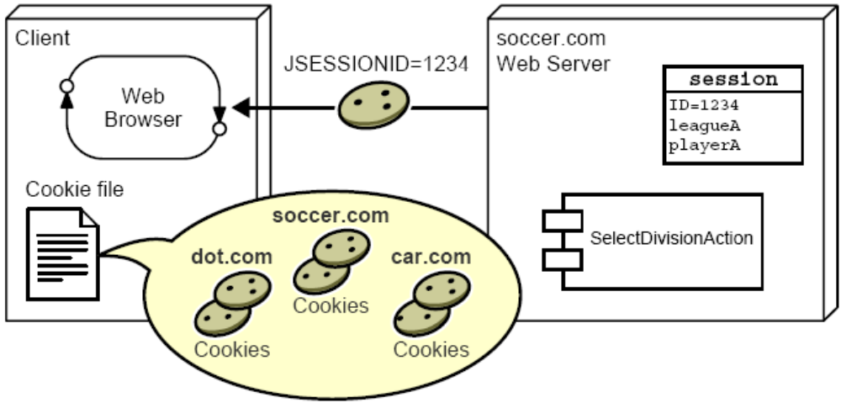
Performing Session Management Using Cookies
The web container sends a JSESSIONID cookie to the client:
Notes:
Use Slides 17, 18, and 19 to explain about performing session management using cookies.

Slide 18
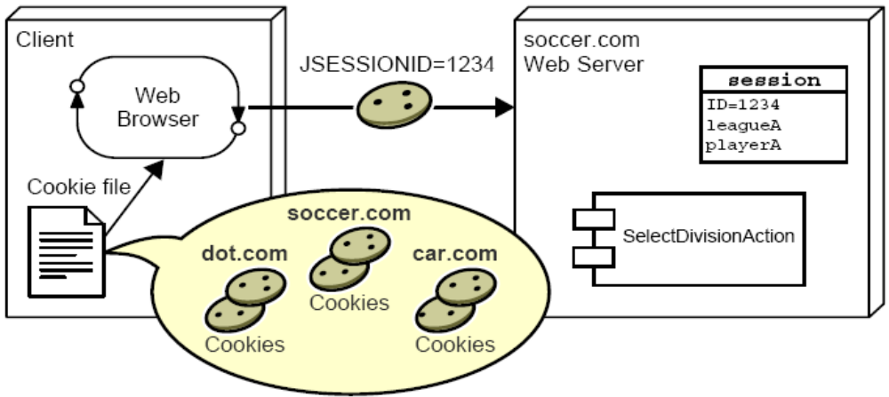
Performing Session Management Using Cookies (Contd.)
The JSESSIONID cookie is sent in all subsequent requests:

Slide 19
Performing Session Management Using Cookies (Contd.)
The cookie mechanism is the default session management strategy.
There is nothing special that you code in your servlets to use this session strategy.
Unfortunately, some users turn off cookies on their browsers.

Slide 20
Demo: Performing Session Management Using Cookies
Demo: Performing Session Management Using Cookies
To perform session management by using cookies, you need to perform the following tasks:
  Create the CookieDemo project in NetBeans IDE
  Build the project.
  Run the project.
Notes:
In this demo, you demonstrate the Session management capabilities in a Web application. You can run the project, CookieDemo, stored at Datafiles For Faculty\Session10\Demo1\CookieDemo.zip file in the TIRM CD for demonstration.
Before running the CookieDemo project in NetBeans IDE 5.5.1, you need to set the Param Value of the data-directory context parameter by following the steps given below:
Open the web.xml file in the WEB-INF directory of the CookieDemo project.
Select the General tab.
Expand the Context Parameters node.
Select the data-directory under the Param Name attribute.
Click the Edit button. The Edit Context Parameter dialog box is displayed.
Change the path of the data directory of the CookieDemo project in the Param Value text box.
Click the OK button.

Slide 21
Using URL-Rewriting for Session Management
URL-rewriting is used when cookies cannot be used.
The server appends extra data on the end of each URL.
The server associates that identifier with data it has stored about that session.
With this URL:
  http://host/path/file;jsessionid=123 session information is jsessionid=123.
Notes:
Use Slides 20 and 21 to explain about using URL-Rewriting for session management.

Slide 22
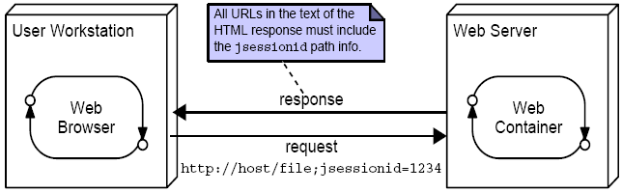
Using URL-Rewriting for Session Management (Contd.)

Slide 23
URL-Rewriting Implications
Every HTML page that participates in a session (using
URL-rewriting) must include the session ID in all URLs in those pages. This requires dynamic generation.
Use the encodeURL method on the response object to guarantee that the URLs include the session ID information.
For example, in the EnterPlayerForm view the action attribute on the form tag must be encoded:
Notes:
Use this slide to explain about the URL-Rewriting implications. If you are using JSP pages, then it is trivial to perform
URL-rewriting by using an expression tag:
<form action=’<%= response.encodeURL(“register”) %>’ method=’POST’>
The html tag library included with the Struts application performs URL-rewriting. For example, you could
accomplish the same action with the tag:
<html:form action=”register”>
The JSTL url tag also performs URL-rewriting:
<c:url value=”nextPage.jsp”>
There is a third session management strategy that is suggested by the Servlet specification. This strategy uses an encryption key used by the HTTPS protocol as the session ID.
There is also a method called encodeRedirectURL that performs the same transformation of a URL string
that you can send to the sendRedirect method of the HttpServletResponse object.

Slide 24
Demo: Performing Session Management Using URL-Rewriting
Demo: Performing Session Management Using URL-Rewriting
To perform session management by using URL-Rewriting, you need to perform the following tasks:
  Create the RewritingDemo project in NetBeans IDE
  Build the project.
  Run the project.
Notes:
In this demo, you demonstrate the Session management capabilities in a Web application. You can run the project, RewritingDemo, stored at Datafiles For Faculty\Session10\Demo2\RewritingDemo.zip file in the TIRM CD for demonstration.
First, turn off cookies in your browser and run the CookieDemo project. It fails when you attempt to Select a Division. You get the Error page, but with null as the only error listed. This indicates a NullPointerException when the register service object tries to use null for the league.
Now, demonstrate the URL rewriting demo. Before running the RewritingDemo project in NetBeans IDE 5.5.1, you need to set the Param Value of the data-directory context parameter by following the steps given below:
Open the web.xml file in the WEB-INF directory of the RewritingDemo project.
Select the General tab.
Expand the Context Parameters node.
Select the data-directory under the Param Name attribute.
Click the Edit button. The Edit Context Parameter dialog box is displayed.
Change the path of the data directory of the RewritingDemo project in the Param Value text box.
Click the OK button.

Slide 25
Summary
In this session, you learned:
  Use cases that must share data across multiple HTTP requests require session management.
  The web container supplies a session management mechanism because HTTP is a stateless protocol.
  A web application can store and retrieve session-scoped data in the HttpSession object which is retrieved from the request object.
  The default session management mechanism uses HTTP cookies.
  Web containers must also support URL-rewriting for session management when the client has cookies turned off.
Notes:
End the session by discussing the summary points as given in Slide 23.

